Slide 1
Initial Memory in Heat Production
The Fifth KIAS Conference on Statistical Physics
Nonequilibrium Statistical Physics of Complex Systems
Chulan Kwon, Myongji University
Jaesung Lee, Kias
Kwangmoo Kim, Kias
Hyunggyu Park, Kias
Notes:
This template can be used as a starter file for presenting training materials in a group setting.
Sections
Sections can help to organize your slides or facilitate collaboration between multiple authors. On the Home tab under Slides, click Section, and then click Add Section.
Notes
Use the Notes pane for delivery notes or to provide additional details for the audience. You can see these notes in Presenter View during your presentation.
Keep in mind the font size (important for accessibility, visibility, videotaping, and online production)
Coordinated colors
Pay particular attention to the graphs, charts, and text boxes.
Consider that attendees will print in black and white or grayscale. Run a test print to make sure your colors work when printed in pure black and white and grayscale.
Graphics, tables, and graphs
Keep it simple: If possible, use consistent, non-distracting styles and colors.
Label all graphs and tables.

Slide 2
I. Introduction
5th KIAS Conference-NSPCS12
- path dependent
accumulated incessantly in time in nonequilibrium steady state
(NESS)
- Fluctuation theorem
Thermodynamic first law
Steady state FT for entropy production

Slide 3
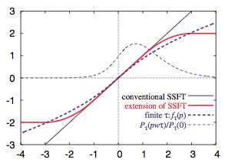
I. Introduction
5th KIAS Conference-NSPCS12
U. Seifert, PRL 95, 040602 (2005)
M. Esposito and V. den Broeck,
PRL 104, 090601 (2010)
R. van Zon and E. Cohen,
PRL 91, 110601 (2003)
“Extended fluctuation theorem”
J.D. Noh and J.-M. Park,
Phys. Rev. Lett. 108, 240603
(2012)
should depend on initial distribution.

Slide 4
II. Equilibration process
5th KIAS Conference-NSPCS12
Dissipated power
Injected power
Total heat
Calculate

Slide 5
II. Equilibration Process
5th KIAS Conference-NSPCS12
Saddle-point integration near the branch point
Not a Gaussian integral!

Slide 6
II. Equilibration Process
5th KIAS Conference-NSPCS12

Slide 7
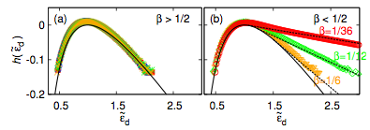
II. Equilibration Process
5th KIAS Conference-NSPCS12
Phase transition in the shape of the heat distribution function
at β=1/2

Slide 8
III. Dragged Harmonic Potential
5th KIAS Conference-NSPCS12
Initial distribution
Heat production
Probability density
function for heat

Slide 9
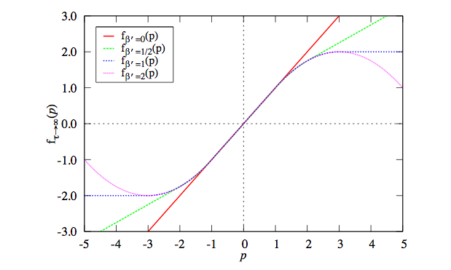
III. Dragged Harmonic Potential
5th KIAS Conference-NSPCS12
FT for heat holds for flat initial distribution, β=0

Slide 10
III. Dragged Harmonic Potential
5th KIAS Conference-NSPCS12
Large deviation form
LDF is absent in the positive tail for β=0
where there is no exponential decay, but a power-decay
which can be seen from the 1/τ correction in the exponent

Slide 11
IV. Summary
5th KIAS Conference-NSPCS12
1. For the equilibration process of the Brownian motion
the phase transition takes place in the shape of heat
distribution at β=1/2.
2. For the dragged harmonic potential the FT for heat holds
for a flat initial distribution, β=0. The modification of FT
depends for on β.
3. The correction to the LDF needs a nontrivial saddle point
integration near the branch point that is not a conventional
Gaussian integral. Our result may be useful for other cases
in which the generating function, the Fourier transform, of
the distribution function with power-law singularity, as the case
of heat and work distribution.

