Slide 1

Long-range correlations in driven systems
David Mukamel

Slide 2
Driven, non-equilibrium systems
systems with currents
do not obey detailed balance
$P\left(C\right)$ the probability to be at a microscopic configuration C at time t

Slide 3
Typical simple examples
heat current
T₁
T₂
T₁>T₂
charge current
E
What are the steady state properties of such systems?
It is well known that such systems exhibit long-range correlations
when the dynamics involves some conserved parameter.

Slide 4
Outline
Will discuss a few examples where long-range correlations show up
and consider some consequences
Example I: Effect of a local drive on the steady state of a system
Example II: Linear drive in two dimensions: spontaneous symmetry
breaking

Slide 5
Example I :Local drive perturbation
T. Sadhu, S. Majumdar, DM, Phys. Rev. E 84, 051136 (2011)

Slide 6

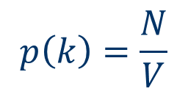
Local perturbation in equilibrium
Particles diffusing (with exclusion) on a grid
occupation number $τ_{i}=0,1$
N particles
V sites
$$p\left(k\right)=\frac{N}{V}$$
Prob. of finding a particle at site k

Slide 7


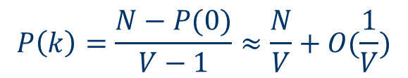
Add a local potential u at site 0
1
1
1
$$e^{βu}$$
1
N particles
V sites
0
1
$$1$$
$$\left(V−1\right)P\left(k\right)+P\left(0\right)=N ( k≠0)$$
$$P\left(k\right)=\frac{N−P(0)}{V−1}≈\frac{N}{V}+O(\frac{1}{V})$$
The density changes only locally.

Slide 8
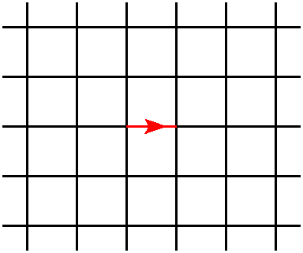
How does a local drive affect the steady-state of a system?

Slide 9
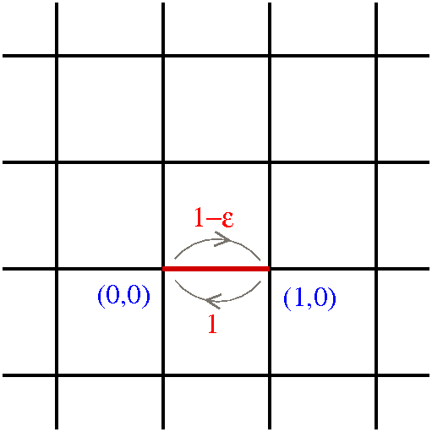
A single driving bond

Slide 10
Main results:
In d ≥ 2 dimensions both the density and the local current
decay algebraically with the distance from the driven bond.
The same is true for local arrangements of driven bond.
The power law of the decay depends on the specific
configuration.
In d=2 dimensions a close correspondence to electrostatics
is found, with analogous variables to electric and magnetic
fields E, H.

Slide 11
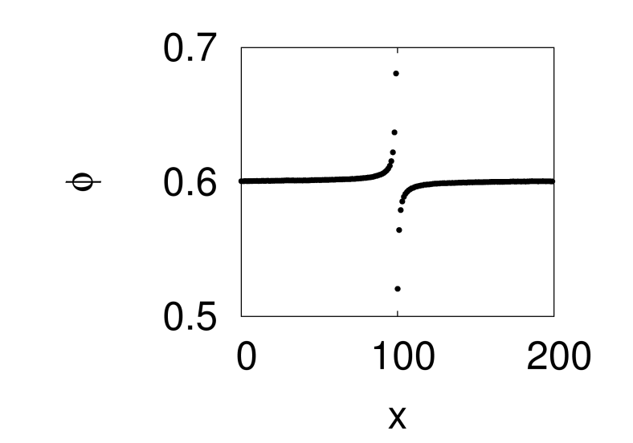
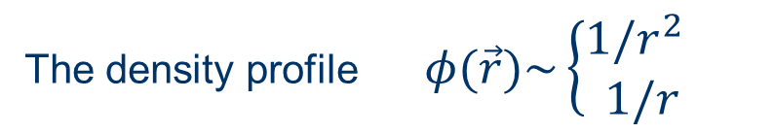
Density profile (with exclusion)
The density profile $φ(\vec{r})\sim \left\{\begin{aligned}1/r^{2 } \\ 1/r\end{aligned}\right.$
along the y axis
in any other direction

Slide 12

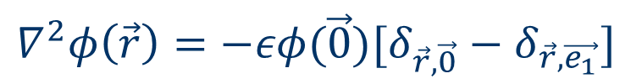
Non-interacting particles
Time evolution of density:
$∂_{t}φ\left(\vec{r}, t\right)=∇^{2}\left(\vec{r}, t\right)+εφ\left(\vec{0},t\right)[δ_{\vec{r},\vec{0}}−δ_{\vec{r},\vec{e_{1}}}]$
$$∇^{2}=φ\left(m+1,n\right)+φ\left(m−1,n\right)+φ\left(m,n+1\right)+φ\left(m,n−1\right)−4φ(m,n)$$
The steady state equation
$$∇^{2}φ\left(\vec{r}\right)=−εφ(\vec{0})[δ_{\vec{r},\vec{0}}−δ_{\vec{r},\vec{e_{1}}}]$$
particle density $→$ electrostatic potential of an electric dipole

Slide 13



$$∇^{2}φ\left(\vec{r}\right)=−εφ(\vec{0})[δ_{\vec{r},\vec{0}}−δ_{\vec{r},\vec{e_{1}}}]$$
The dipole strength has to be determined self consistently.
Green’s function
$$∇^{2}G\left(\vec{r},{\vec{r}}_{o}\right)=−δ_{\vec{r},{\vec{r}}_{o}}$$
solution
$φ\left(\vec{r}\right)=ρ+εφ\left(\vec{0}\right)[G\left(\vec{r},\vec{0}\right)−G(\vec{r},{\vec{e}}_{1})]$
Unlike electrostatic configuration here the strength of
the dipole should be determined self consistently.

Slide 14
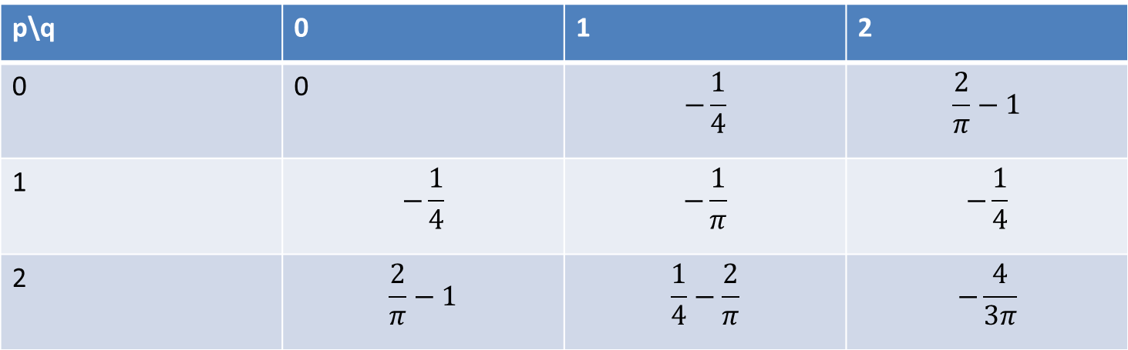
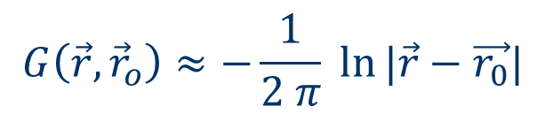
Green’s function of the discrete Laplace equation
p\q | 0 | 1 | 2
0 | 0 | $$−\frac{1}{4}$$ | $$\frac{2}{π}−1$$
1 | $$−\frac{1}{4}$$ | $$−\frac{1}{π}$$ | $$−\frac{1}{4}$$
2 | $$\frac{2}{π}−1$$ | $$\frac{1}{4}−\frac{2}{π}$$ | $$−\frac{4}{3π}$$
$$G\left(\vec{r},{\vec{r}}_{o}\right)≈−\frac{1}{2 π} ln⁡|\vec{r}−\vec{r_{0}}|$$

Slide 15

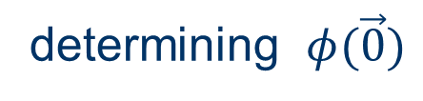

determining $φ(\vec{0})$
To find $φ(\vec{0})$ one uses the values $G\left(\vec{0},\vec{0}\right)=0 , G\left(\vec{0},{\vec{e}}_{1}\right)=−\frac{1}{4}$
$$φ\left(\vec{0}\right)=\frac{ρ}{1−\frac{ε}{4}}$$

Slide 16
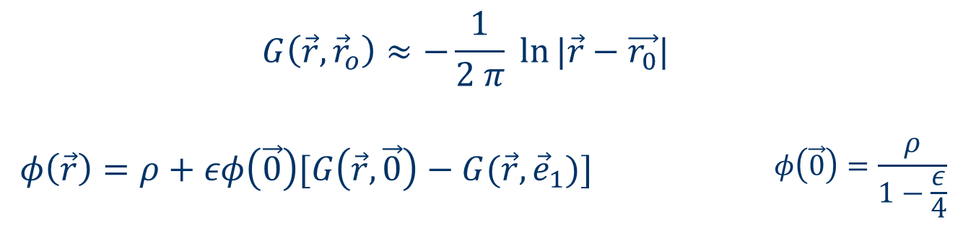
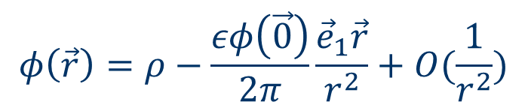
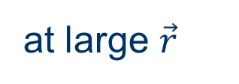
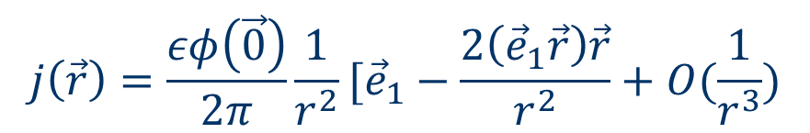
at large $\vec{r}$
$$φ\left(\vec{r}\right)=ρ−\frac{εφ\left(\vec{0}\right)}{2π}\frac{{\vec{e}}_{1}\vec{r}}{r^{2}}+O(\frac{1}{r^{2}})$$
density:
$$j\left(\vec{r}\right)=\frac{εφ\left(\vec{0}\right)}{2π}\frac{1}{r^{2}}[{\vec{e}}_{1}−\frac{2\left({\vec{e}}_{1}\vec{r}\right)\vec{r}}{r^{2}}+O(\frac{1}{r^{3}})$$
current:

Slide 17
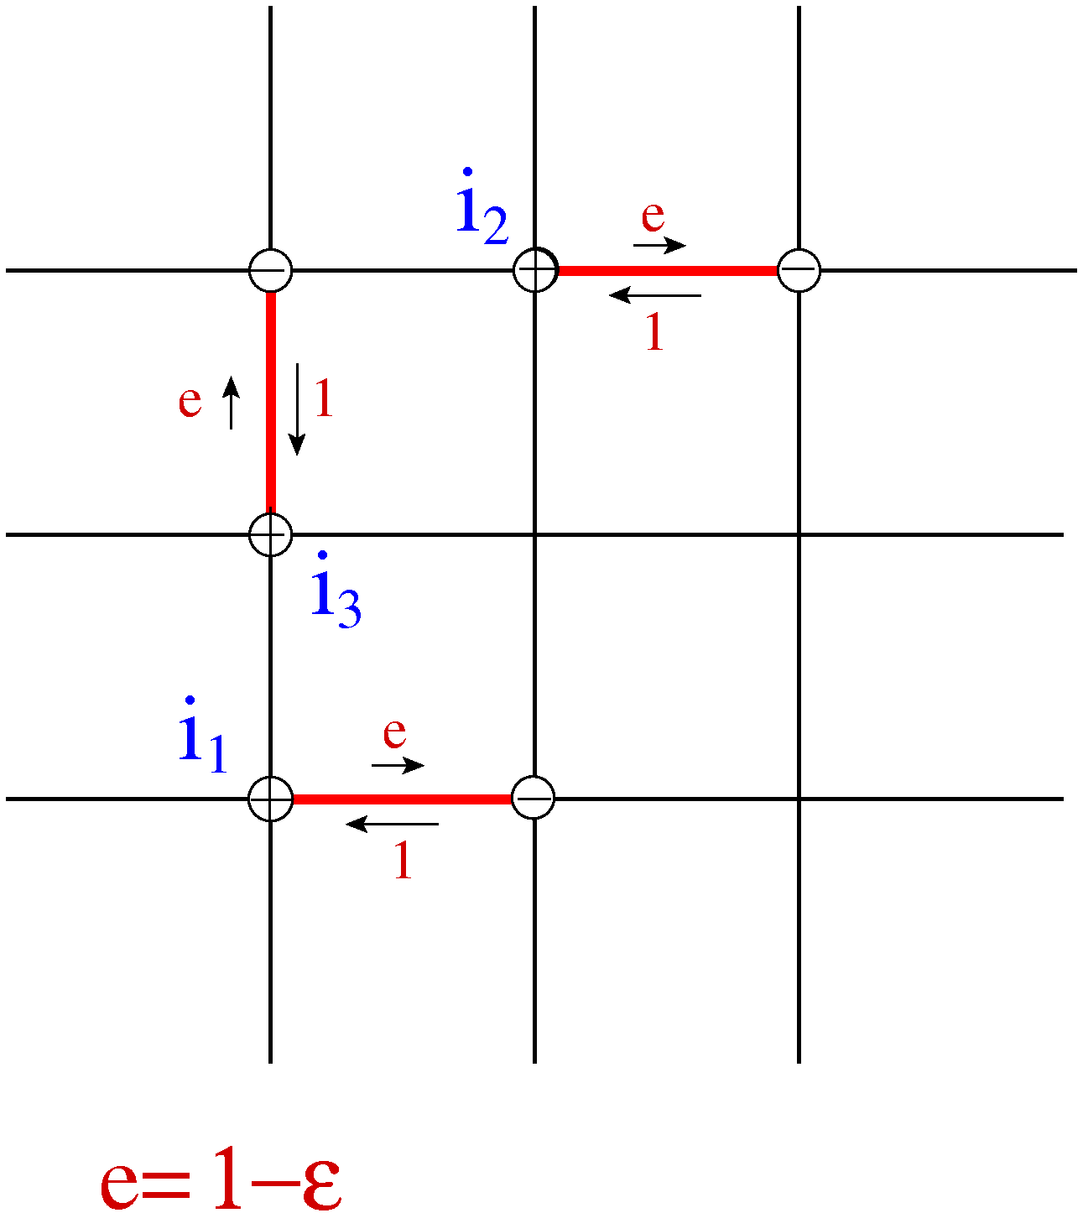
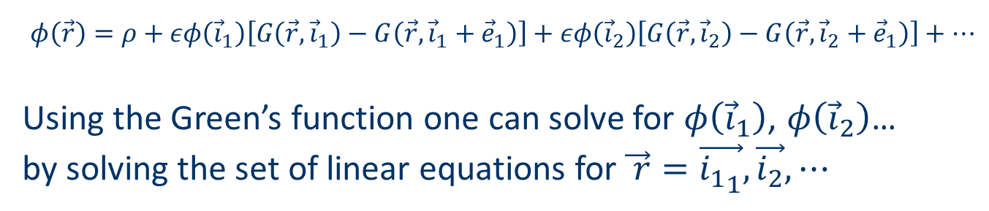
Multiple driven bonds
$φ\left(\vec{r}\right)=ρ+εφ\left({\vec{i}}_{1}\right)\left[G\left(\vec{r}, {\vec{i}}_{1}\right)−G\left(\vec{r}, {\vec{i}}_{1}+{\vec{e}}_{1}\right)\right]+εφ\left({\vec{i}}_{2}\right)\left[G\left(\vec{r}, {\vec{i}}_{2}\right)−G\left(\vec{r}, {\vec{i}}_{2}+{\vec{e}}_{1}\right)\right]+…$
Using the Green’s function one can solve for $φ\left({\vec{i}}_{1}\right)$, $φ\left({\vec{i}}_{2}\right)$…
by solving the set of linear equations for $\vec{ r}=\vec{{i_{1}}_{1}},\vec{i_{2}},⋯$

Slide 18
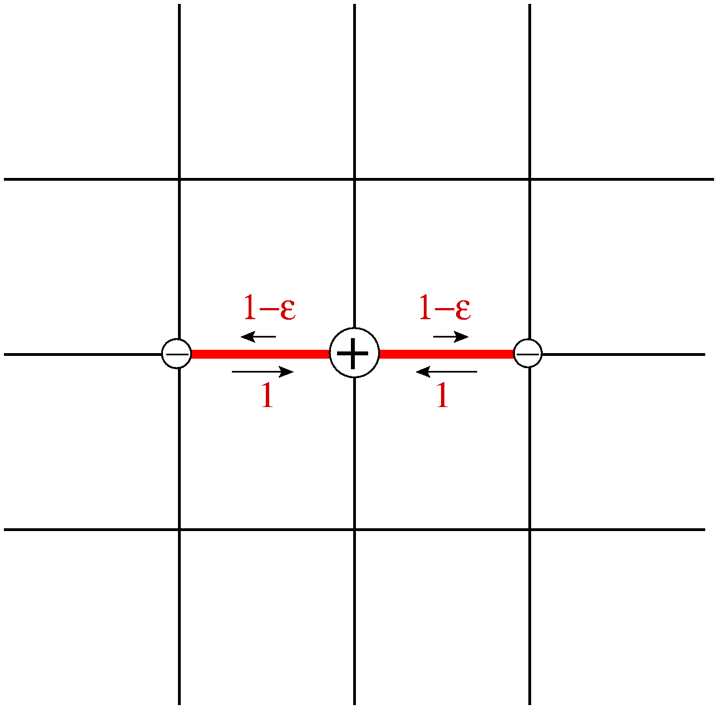
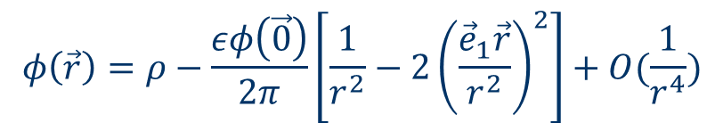
Two oppositely directed driven bonds – quadrupole field
The steady state equation: $∇^{2}φ\left(\vec{r}\right)=−εφ(\vec{0})[2δ_{\vec{r},\vec{0}}−δ_{\vec{r},{\vec{e}}_{1}}{−δ}_{\vec{r},{−\vec{e}}_{1}}]$
$$φ\left(\vec{r}\right)=ρ−\frac{εφ\left(\vec{0}\right)}{2π}\left[\frac{1}{r^{2}}−2{\left(\frac{{\vec{e}}_{1}\vec{r}}{r^{2}}\right)}^{2}\right]+O(\frac{1}{r^{4}})$$

Slide 19
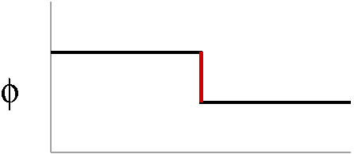
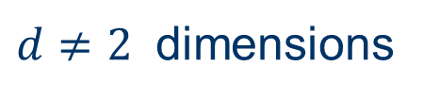

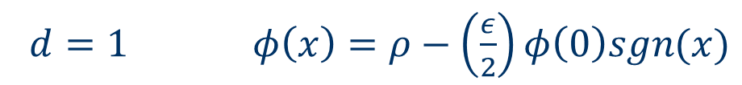
$d≠2$ dimensions
$d≥2$ $φ\left(\vec{r}\right)∼\frac{1}{r^{d−1}}$
$d=1 φ\left(x\right)=ρ−\left(\frac{ε}{2}\right)φ\left(0\right)sgn(x)$
$G\left(x,x_{o}\right)=−\frac{\left|x−x_{o}\right|}{2}$

Slide 20
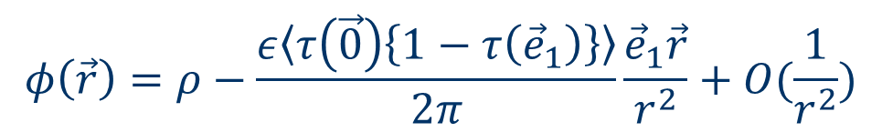

The model of local drive with exclusion
Here the steady state measure is not known however one can
determine the behavior of the density.
$$∂_{t}φ\left(\vec{r}, t\right)=∇^{2}\left(\vec{r}, t\right)+ε〈τ\left(\vec{0}\right)\left\{1−τ\left({\vec{e}}_{1}\right)\right\}〉[δ_{\vec{r},\vec{0}}−δ_{\vec{r},\vec{e_{1}}}]$$
$τ=0,1$is the occupation variable
$$φ\left(\vec{r}\right)=ρ−\frac{ε〈τ\left(\vec{0}\right)\left\{1−τ\left({\vec{e}}_{1}\right)\right\}〉}{2π}\frac{{\vec{e}}_{1}\vec{r}}{r^{2}}+O(\frac{1}{r^{2}})$$

Slide 21

$$φ\left(\vec{r}\right)=ρ−\frac{ε〈τ\left(\vec{0}\right)\left\{1−τ\left({\vec{e}}_{1}\right)\right\}〉}{2π}\frac{{\vec{e}}_{1}\vec{r}}{r^{2}}+O(\frac{1}{r^{2}})$$
The density profile is that of the dipole potential with a dipole
strength which can only be computed numerically.

Slide 22
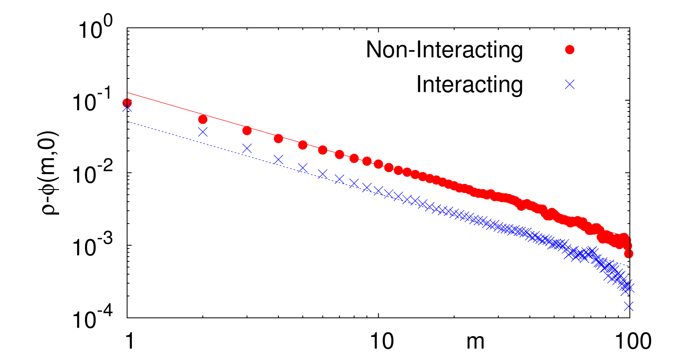
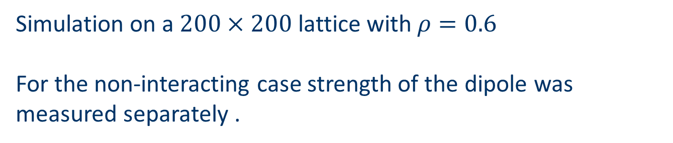
Simulation results
Simulation on a $200×200$ lattice with $ρ=0.6$
For the non-interacting case strength of the dipole was measured separately .

Slide 23
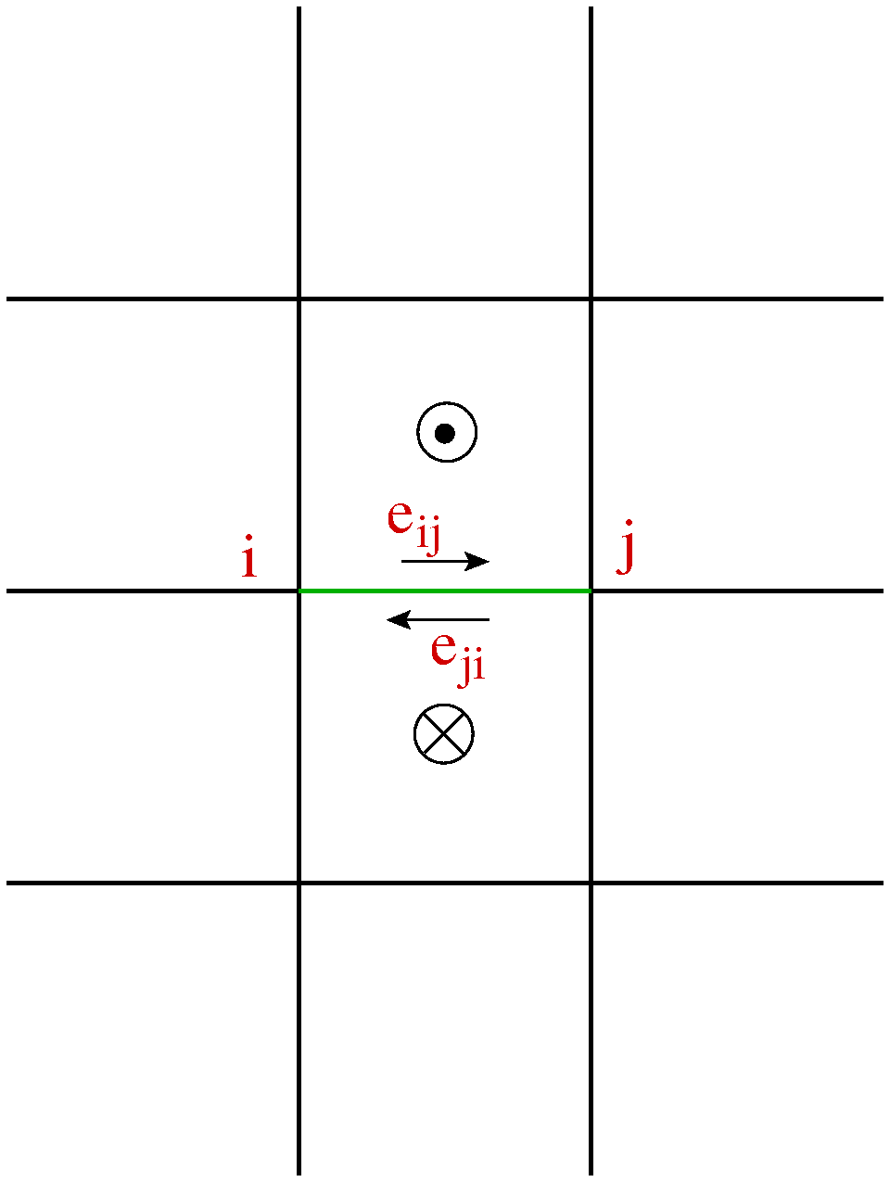

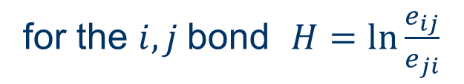
Magnetic field analog
for $i→j$process $H=\ln{[e_{i,j}] }$
for the $i,j$bond $H=\ln{\frac{e_{ij}}{e_{ji}}}$

Slide 24
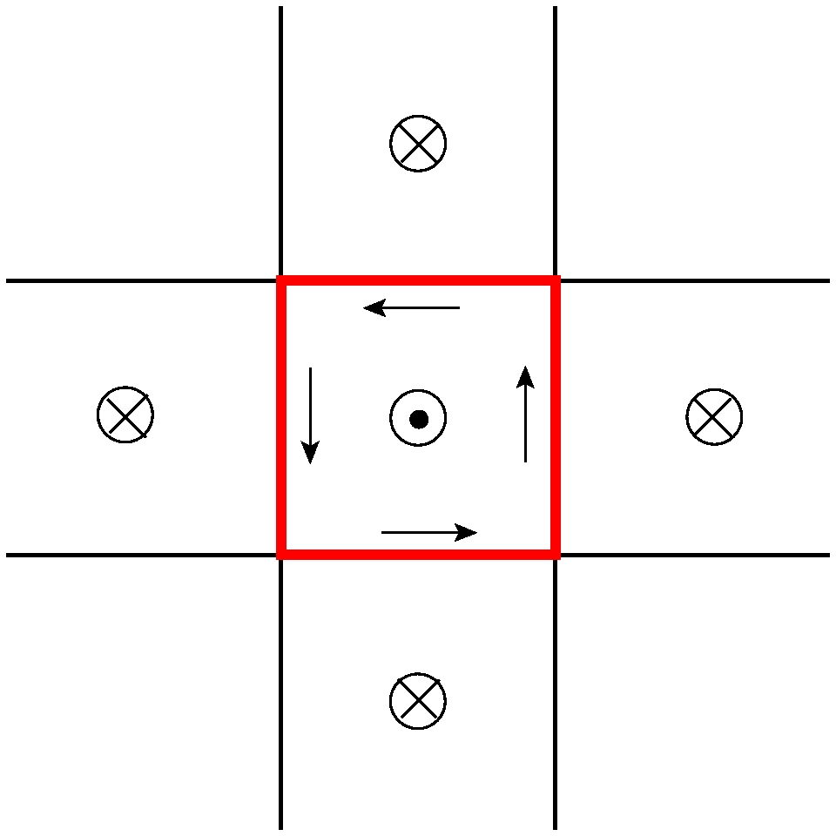
Zero-charge configuration
The density is flat however there are currents

Slide 25
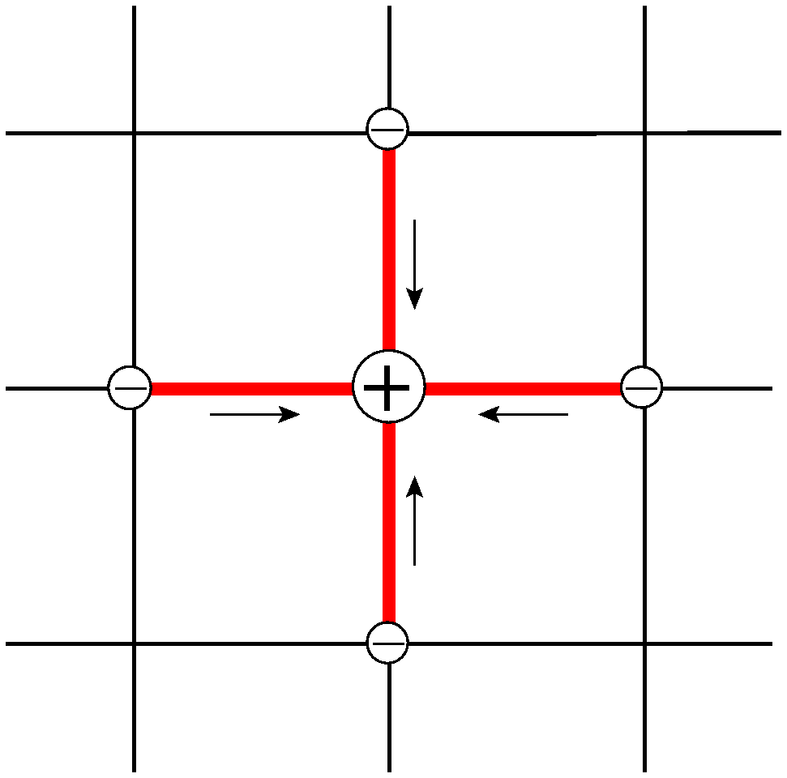
Zero magnetic field configuration
no currents but inhomogeneous density (equilibrium)

Slide 26

In general
non-zero electric field $→$ inhomogeneous density
non-zero magnetic field $→$ currents
zero magnetic field $→$ equilibrium configuration

Slide 27
Example II: a two dimensional model with a driven line
T. Sadhu, Z. Shapira, DM

Slide 28

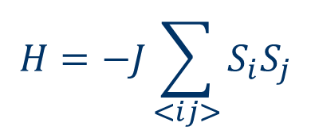
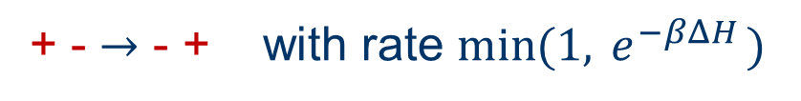
Two dimensional lattice gas (Ising) model (equilibrium)
$$H=−J\sum_{<ij>}{S_{i}S_{j}}$$
$$S_{i}=±1$$
+ particle - vacancy
particle exchange (Kawasaki) dynamics
+ - $→$ - + with rate ${\min{(1, }e}^{−βΔH })$

Slide 29

at $T<T_{c}$
-
+
-

Slide 30



2d Ising model with a row of weak bonds (equilibrium)
$$J$$
+
$$J_{1}$$
-
$$J_{1}<J$$
The weak-bonds row localizes the interface at any temperature $T<T_{c}$

Slide 31



$$J$$
$$J_{1}$$
$$J_{1}<J$$
+
+
-
-
T=0
T>0

Slide 32
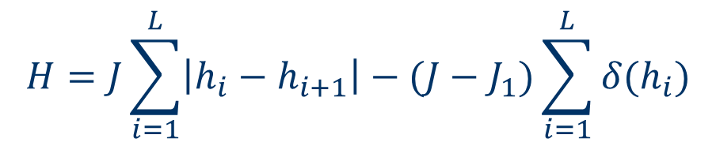
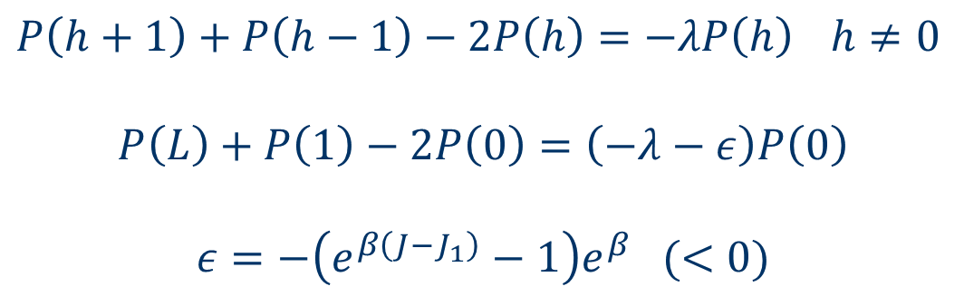
Interface energy at low temperature:
$$H=J\sum_{i=1}^{L}{\left|h_{i}−h_{i+1}\right|−(J−J_{1})\sum_{i=1}^{L}{δ(h_{i})}}$$
$P\left(h\right)$ - the probability of finding the interface at height $h$
$P\left(h+1\right)+P\left(h−1\right)−2P\left(h\right)=−λP\left(h\right)$ $h≠0$
$$P\left(L\right)+P\left(1\right)−2P\left(0\right)=\left(−λ−ε\right)P\left(0\right)$$
$$ε=−\left(e^{β\left(J−J_{1}\right)}−1\right)e^{β} (<0)$$
1d Quantum mechanical particle (discrete space) with a
local attractive potential. The wave function is localized.

Slide 33
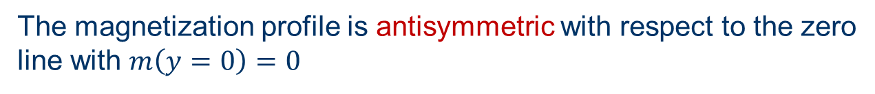
Schematic magnetization profile
The magnetization profile is antisymmetric with respect to the zero
line with $m\left(y=0\right)=0$

Slide 34
Consider now a line of driven bonds
-
+
-

Slide 35
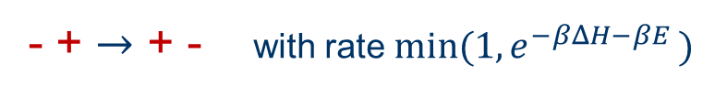
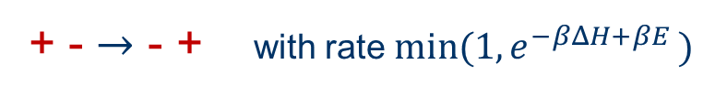

+ - $→$ - + with rate ${min⁡(1,e}^{−βΔH+βE })$
- + $→$ + - with rate $min(1, e^{−βΔH−βE })$
$$H=−J\sum_{<ij>}{S_{i}S_{j}}$$

Slide 36
Main results
The driven line attracts the interface
The interface width is finite (localized)
A spontaneous symmetry breaking takes place
by which the magnetization of the driven line
is non-zero and the magnetization profile is not
antisymmetric, (mesoscopic transition).
The fluctuation of the interface are not symmetric around
the driven line.
These results can be demonstrated analytically in certain limit.

Slide 37
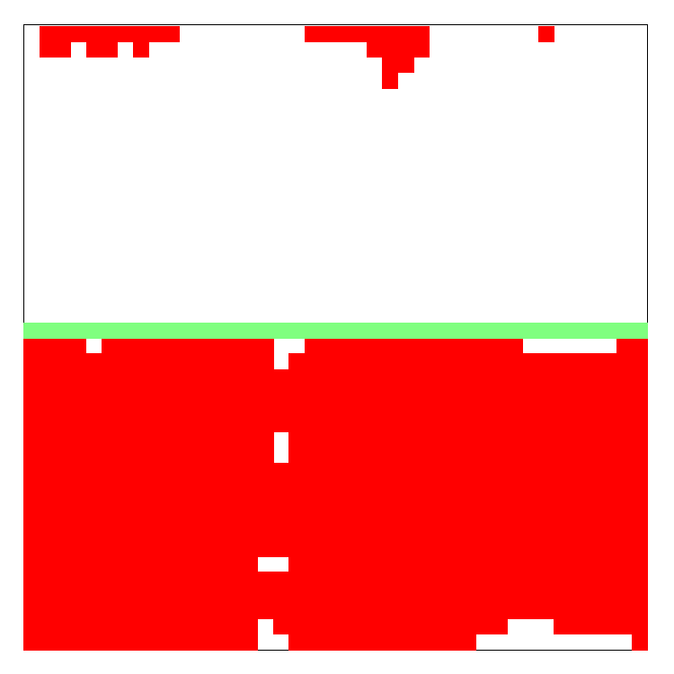
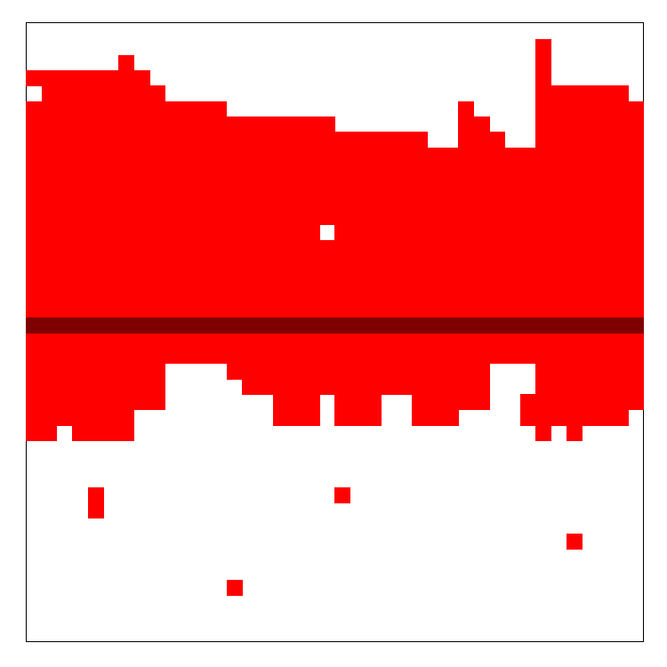
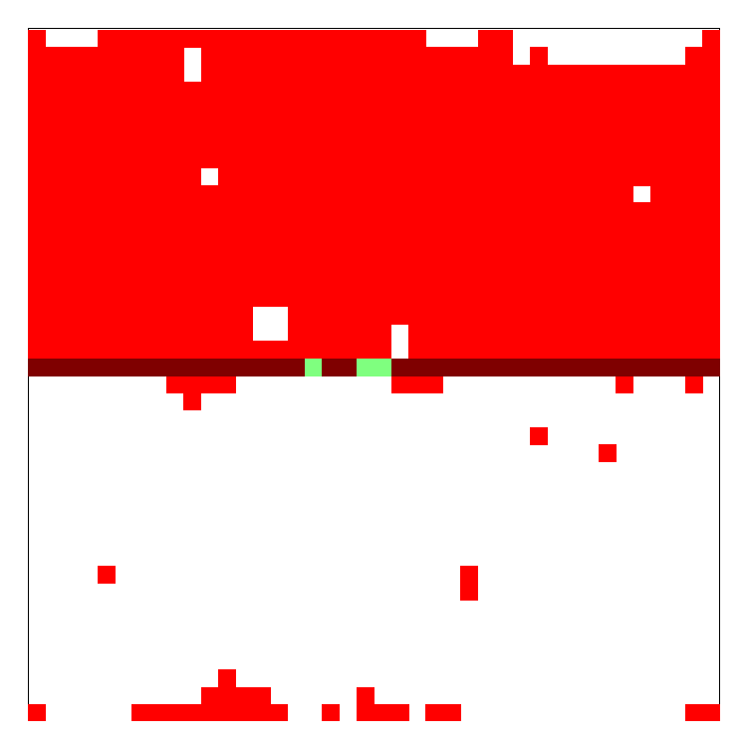
Results of numerical studies
The is attracted by the driven line.
Time= 3e9
Time= 5e9
Time= 6e9

Slide 38
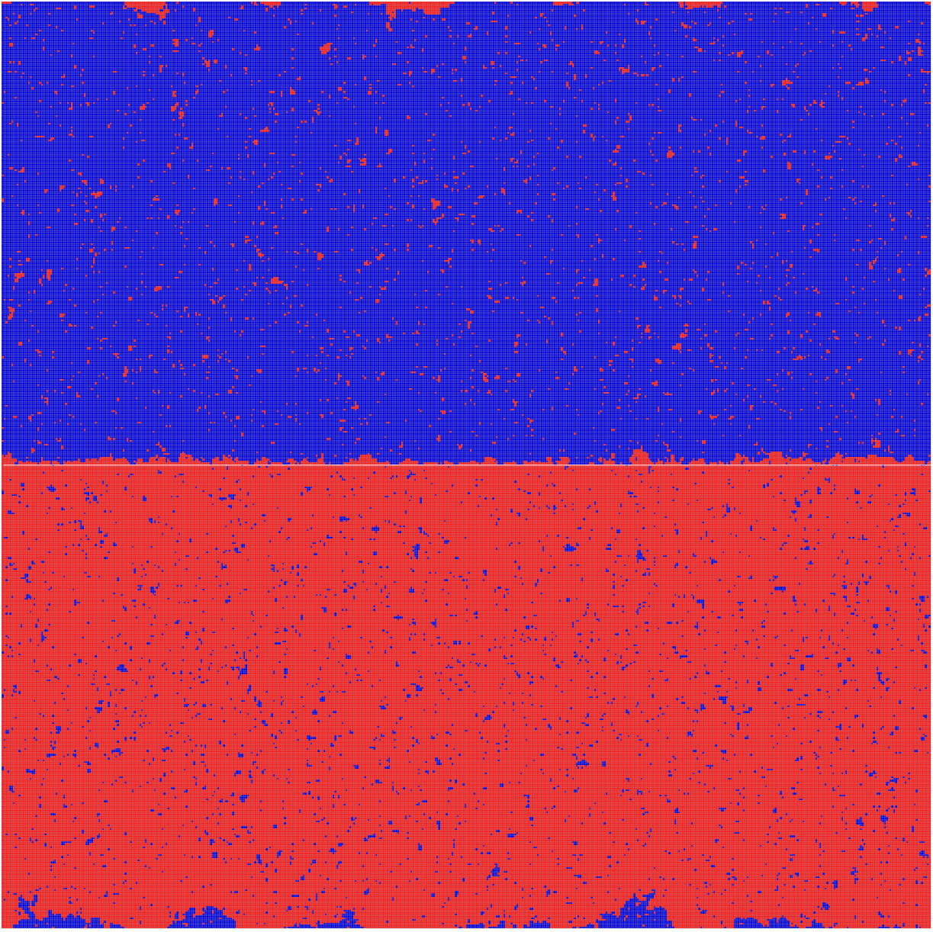
A configuration of the periodic 500X501 lattice at temperature 0.85Tc.

Slide 39
Temporal evolution of the interface position
Periodic 30X31 lattice at temperature 0.6Tc. Driven lane at y=0,
there are around 15 macro-switches on a 10^9 MC steps.

Slide 40
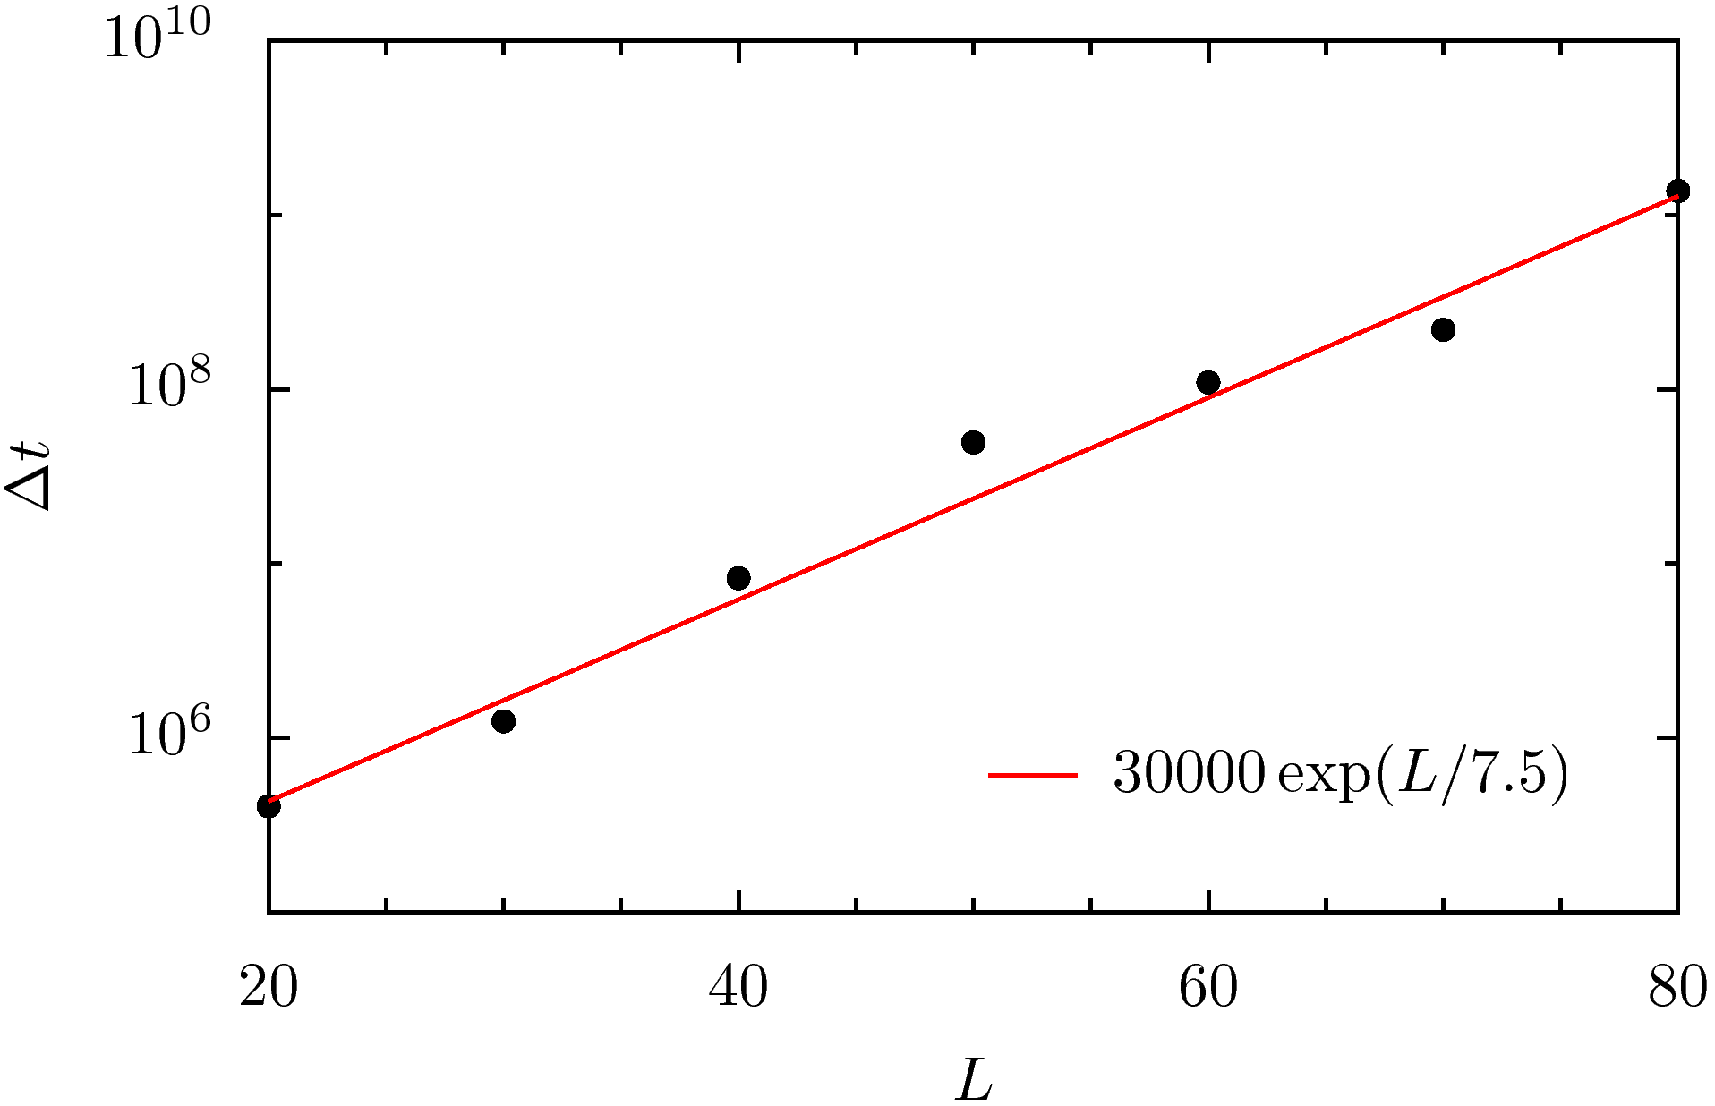

Slide 41
Zoom in
Macroscopic switch
Mesoscopic switches
Periodic 30X31 lattice at temperature 0.57Tc.

Slide 42
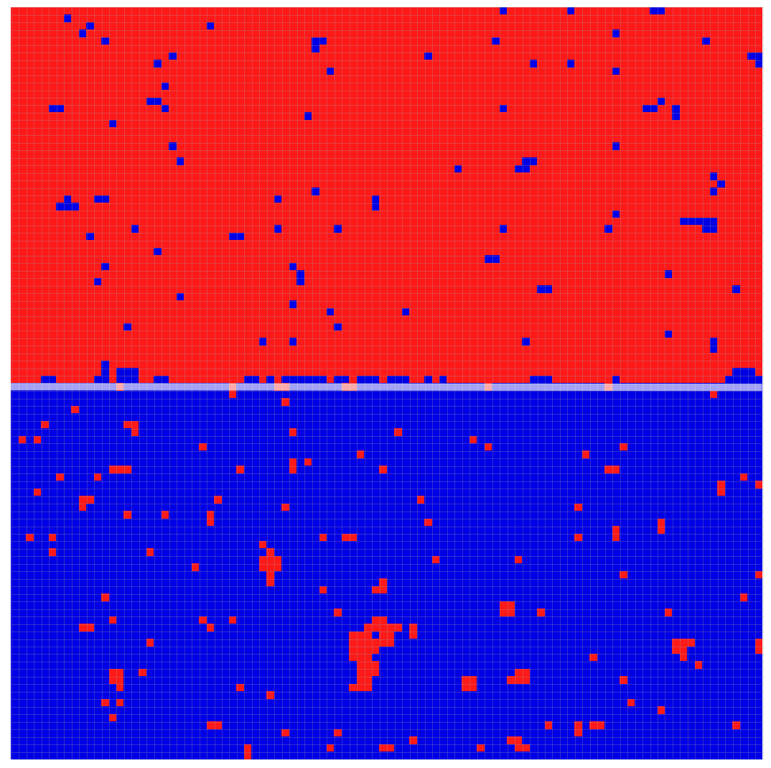
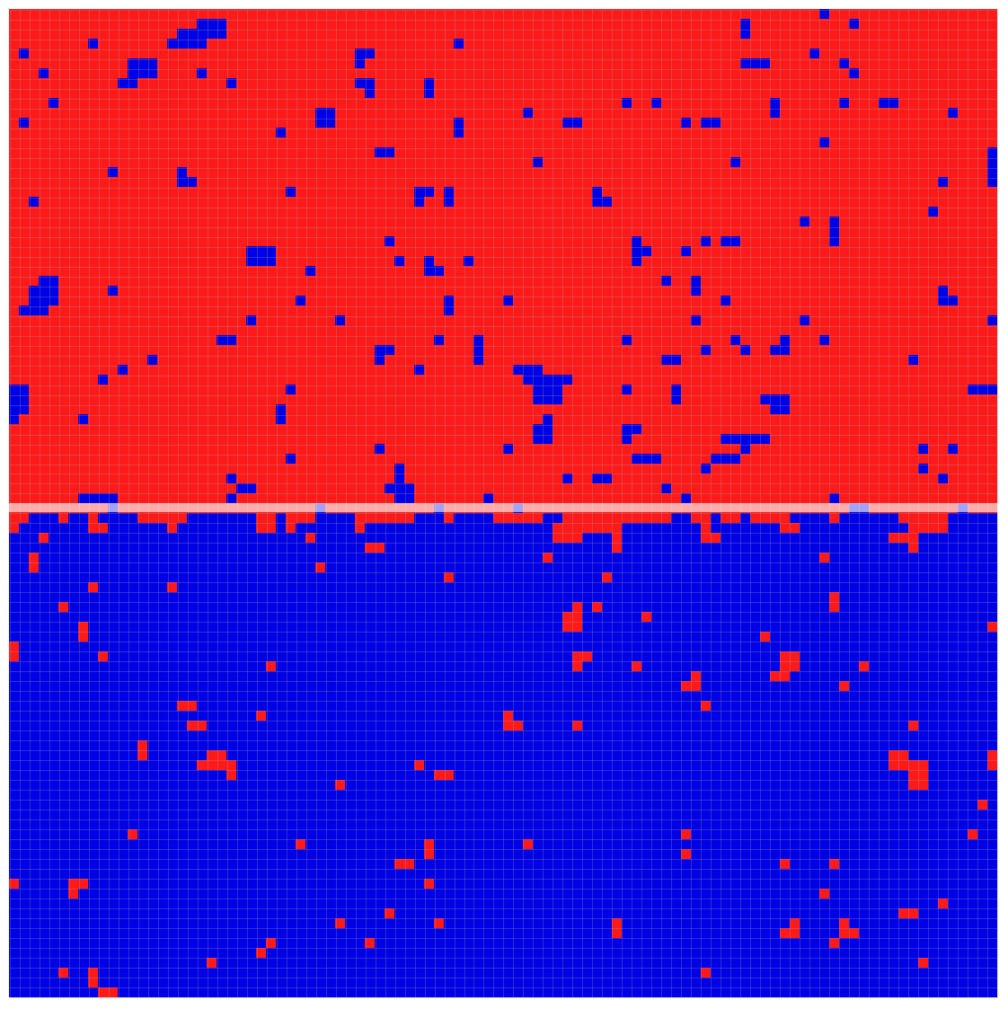
Example of configurations in the two mesoscopic states for a 100X101 with fixed boundary at T=0.85Tc

Slide 43
Schematic magnetization profiles
unlike the equilibrium antisymmetric profile

Slide 44
Asymmetric magnetization profile for a periodic 500X501 lattice at temperature T=0.85Tc.

Slide 45
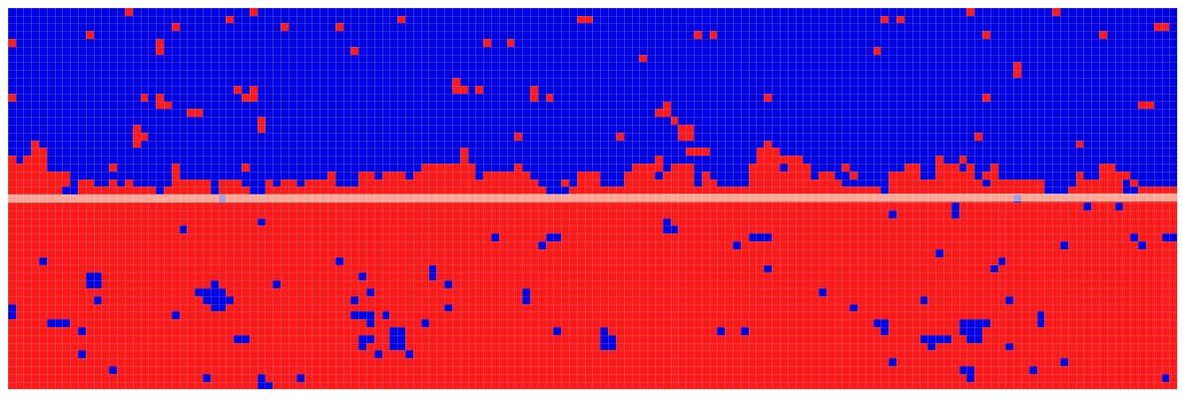

Slide 46
Non-symmetric fluctuations of the interface
A snapshot of the magnetization profile near the two interfaces on a 500X501 square lattice with periodic boundary condition at T=0.85Tc.

Slide 47
Closed boundary conditions
In order to study the mesoscopic switches in more detail
and to establish the existence of spontaneous symmetry breaking
of the driven line we consider the case of closed boundary conditions
- - - - - - - -
+ + + + + + + +

Slide 48
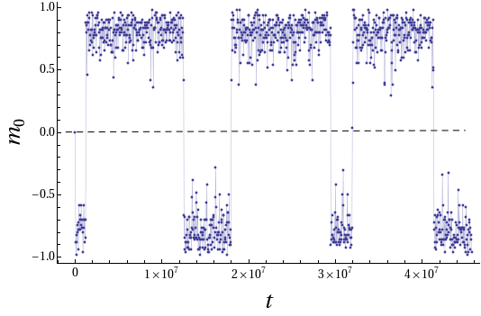
Time series of Magnetization of driven lane for a 100X101 lattice at T= 0.6Tc.

Slide 49
Switching time on a square LX(L+1) lattice with Fixed boundary at T=0.6Tc.

Slide 50
Averaged magnetization profile in the two states
L=100 T=0.85Tc

Slide 51


Analytical approach
In general one cannot calculate the steady state measure of this system.
However in a certain limit, the steady state distribution (the large
deviation function) of the magnetization of the driven line can be calculated.
Slow exchange rate between the driven line and the rest of the system
Large driving field $E≫J$
Low temperature
In this limit the probability distribution of $m_{0}$is $P\left(m_{0}\right)=e^{−LU(m_{0})}$
where the potential (large deviation function) $U\left(m_{0}\right)$ can be computed.

Slide 52
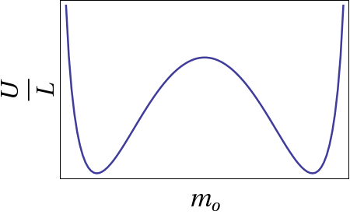


Schematic potential (large deviation function)
$$U$$
$$P\left(m_{0}\right)=e^{−LU(m_{0})}$$

Slide 53



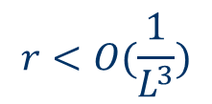

Slow exchange between the line and the rest of the system
$$rw(ΔH)$$
$$+ − ⇆ − +$$
$$r<O(\frac{1}{L^{3}})$$
$$rw(−ΔH)$$
$$w\left(ΔH\right)=min⁡(1,e^{−βΔH})$$
In between exchange processes the systems is
composed of 3 sub-systems evolving independently

Slide 54
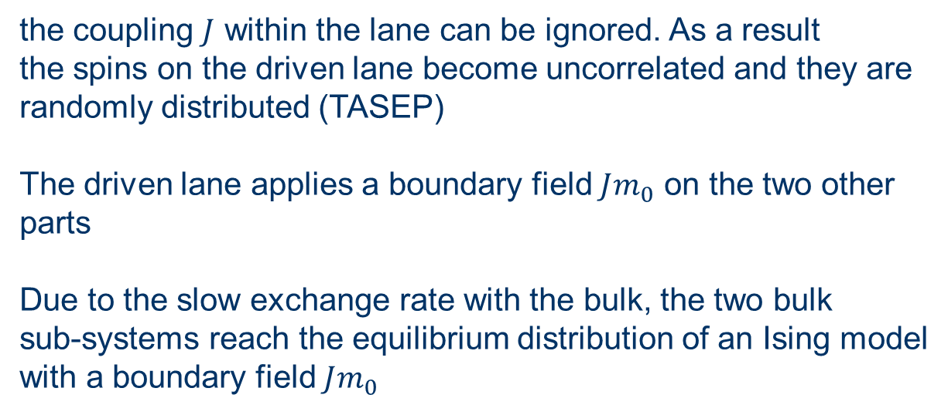

Fast drive $E≫J$
the coupling $J$ within the lane can be ignored. As a result
the spins on the driven lane become uncorrelated and they are
randomly distributed (TASEP)
The driven lane applies a boundary field $Jm_{0}$ on the two other
parts
Due to the slow exchange rate with the bulk, the two bulk
sub-systems reach the equilibrium distribution of an Ising model
with a boundary field $Jm_{0}$
Low temperature limit
In this limit the steady state of the bulk sub systems can
be expanded in T and the exchange rate with the driven line can
be computed.

Slide 55






$m_{o}⟶m_{o}+\frac{2}{L}$ with rate $p(m_{o})$
$m_{o}⟶m_{o}−\frac{2}{L}$ with rate $q(m_{o})$
$$q(m_{0})$$
$$p(m_{0})$$
$m_{o}$performs a random walk with a rate which depends on $m_{o}$
$$P\left(m_{o}=\frac{2k}{L}\right)=\frac{p(0)⋯⋯p(\frac{2\left(k−1\right)}{L})}{q(\frac{2}{L})⋯⋯q(\frac{2k}{L})}≡e^{−U(m_{o})}$$
$$U\left(m_{o}\right)=−\sum_{k=0}^{\frac{m_{o}L}{2}−1}{\ln{p\left(\frac{2k}{L}\right)+\sum_{k=1}^{\frac{m_{o}L}{2}}{q(\frac{2k}{L})}}}$$

Slide 56

Calculate p$\left(m_{o}\right)$ at low temperature
- - - - -
- - - - -
+ - +
+ + + + +
+ + + + +

Slide 57
- - - - -
- - - - -
+ - +
+ + + + +
+ + + + +
contribution to p$\left(m_{o}\right): \frac{1}{8}\left(1−m_{o}\right)⁢{\left(1+m_{o}\right)}^{2}e^{−2βJ}e^{−2βJ_{1}}$
$J_{1}$is the exchange rate between the driven line and the adjacent lines

Slide 58





The magnetization of the driven lane $m_{∘}$changes in steps of $2/L$
Expression for rate of increase, p$(m_{o})$
$$p\left(m_{0}\right)=\frac{1}{8}{\left(1+m_{0}\right)}^{2}\left(1−m_{0}\right)e^{−2β\left(J+J_{1}\right)}$$
$$+\frac{1}{8}[2\left(1+m_{0}\right){\left(1−m_{0}\right)}^{2}\left(e^{−2βJ_{1}}+e^{2βJ_{1}m_{0}}\right)$$
$$+{2\left(1+m_{0}\right)}^{2}\left(1−m_{0}\right){\left(e^{−2βJ_{1}}+e^{2βJ_{1}m_{0}}\right)}^{}$$
$$+{\left(1−m_{0}\right)}^{3}e^{2βJ_{1}m_{0}}]e^{−6βJ}+O{(e}^{−8βJ})$$
$$q\left(m_{o}\right)=p(−m_{o})$$
$$U\left(m\right)=−\int_{0}^{m}{\ln{p\left(k\right)}dk+\int_{0}^{m}{\ln{q\left(k\right)dk}}}$$

Slide 59




$$U$$
This form of the large deviation function demonstrates
the spontaneous symmetry breaking. It also yield the
exponential flipping time at finite $L. (T=0.6T_{c} , J_{1}=J)$
$$P\left(m_{0}\right)=e^{−LU(m_{0})}$$
$$<m_{o}>1−O(e^{−4βJ})$$

Slide 60
Summary
Driven systems exhibit long range correlations under
generic conditions.
Such correlations sometimes lead to long-range order
and spontaneous symmetry breaking which are absent
under equilibrium conditions.
Simple examples of these phenomena have been presented.
A limit of slow exchange rate is discussed which enables
the evaluation of some large deviation functions far from
equilibrium.

